Slide 1
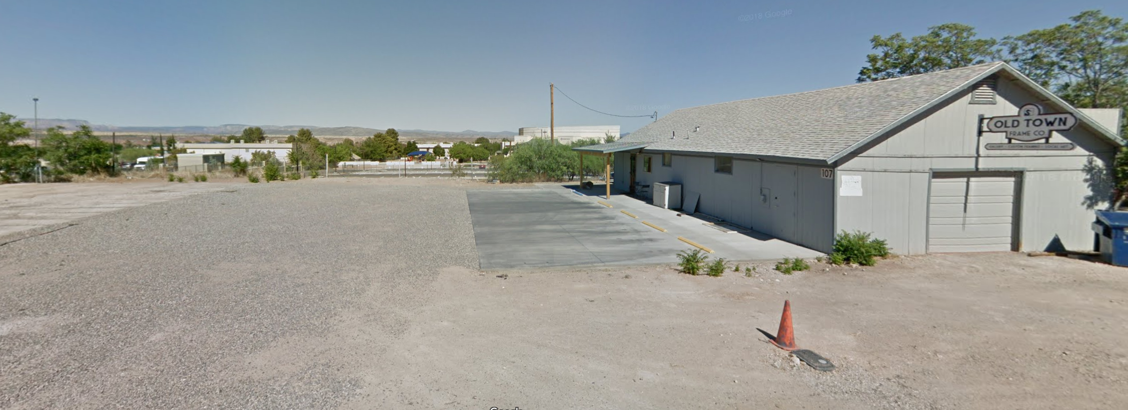
Old Town Frame Company - Land Development Project
CENE486C - Spring 2019
April 26, 2019
Ryan Wolff, Matt Rollins, Mitchell Tulk, Saud Al Saadoon

Slide 2
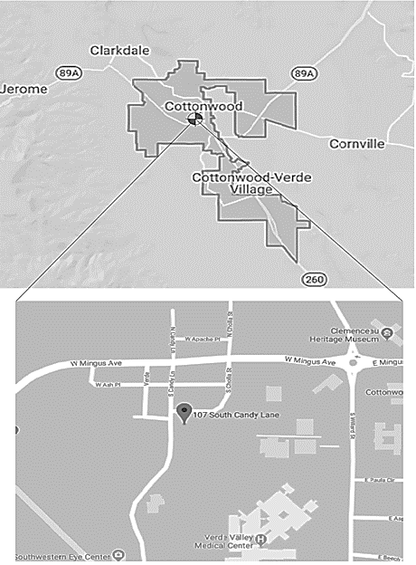

Project Information
Old Town Frame Company
Owned by Trevor Gottschalk
107 S Candy Ln, Cottonwood, AZ
Parcel 406-33-001C
Figure 1: Company Logo. 2018.
Figure 2: Site Location. 2019.

Slide 3
Project Objectives/Exclusions
Objectives
Determine site boundaries
Determine if retaining wall is on site
Develop a parking lot design to reduce runoff
Provide pavement design recommendation
Provide an engineer’s estimate of cost
Create construction plans
Exclusions
Retaining wall design
Pavement design
SWPPP

Slide 4
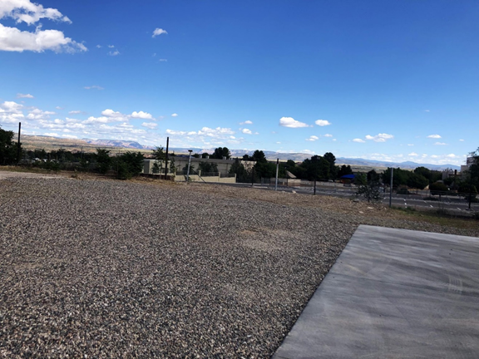
Existing Conditions
Land Development Scope:
  Survey
    Locate property boundaries
  Geotechnical Analysis
  Site Plan
    Existing Conditions
  Parking Lot Design
  Grading and Drainage Plan
  Erosion Control Plan
  Construction Plans
Figure 3: Site View. 2018.

Slide 5
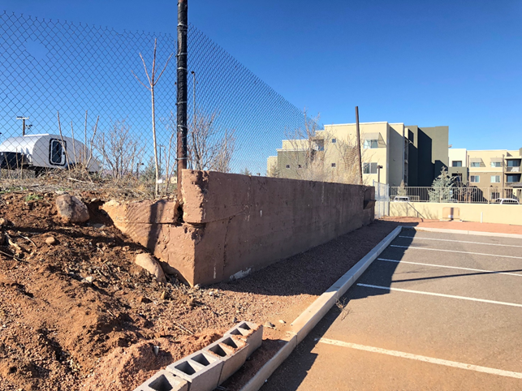
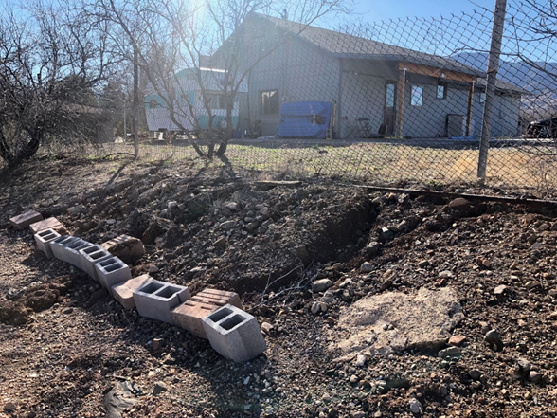
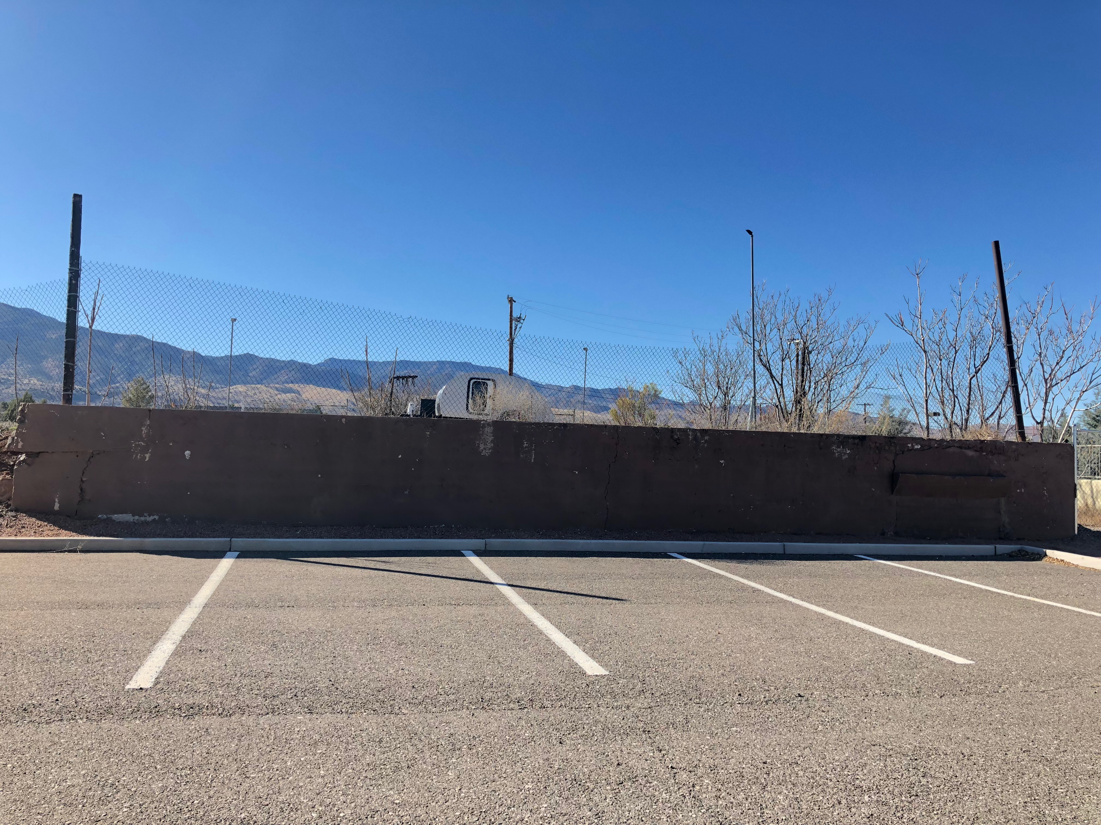
Existing Conditions (cont.)
Figure 4: Existing historic retaining wall. 2018.
Figure 5: Erosion occuring on site. 2018.
Figure 6: Retaining Wall. 2018

Slide 6
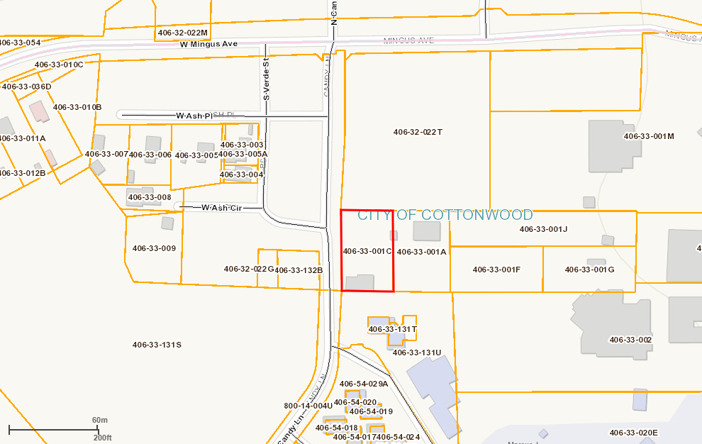
Task 1.1: Existing Mapping
Parcel 406-33-001C
Section 3
Township 16N
Region 03E
Figure 7: Yavapai County GIS Map of Property (in red). 2019.

Slide 7
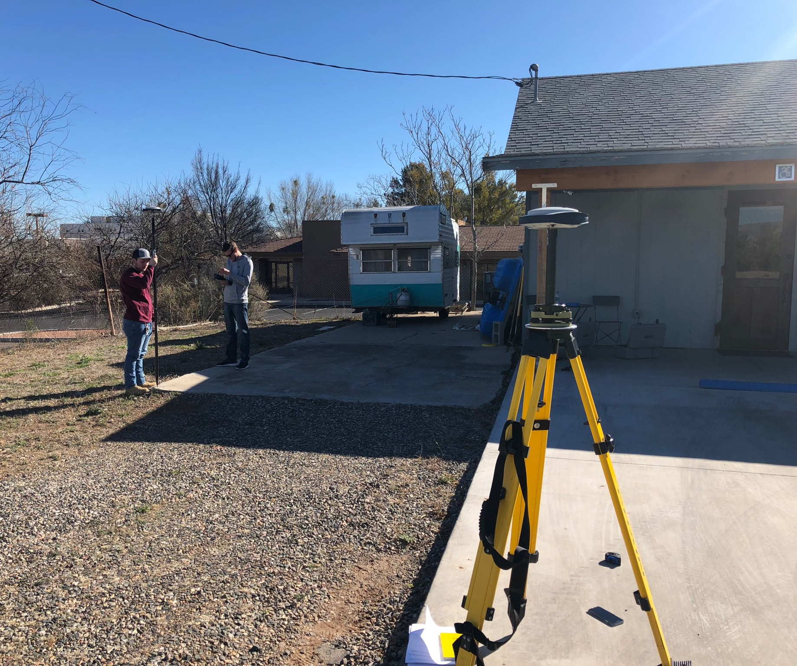
Task 2: Site Investigation
Task 2.1: Lot Sketch
Task 2.2: Field Investigation
  February 2, 2019 at 2:53PM
Task 2.3: Land Survey
  February 8, 2019 at 1:26PM
  GPS survey
  Referenced document from county recorder
Task 2.4: Soil Sampling
  3 samples taken (south, middle, wall)

Slide 8
Task 3: Geotechnical Analysis
Table 1: Summary of geotechnical results.
Sample | South | Middle | Wall
Moisture Content | 13% | 13.1% | 24.6%
Passing No. 200 Sieve | 23.6% | 32% | 39.9%
Liquid Limit | 27 | 28 | 48
Plastic Limit | 20 | 17 | 18
Plasticity Index | 7 | 11 | 30
Soil Classification | Sandy Clay | Gravely Clay | Fatty Clay
Task 3.3.1: Moisture Content Testing (ASTM DD2216-10)
Task 3.3.2: Atterberg Limits Testing (ASTM D4318)
Task 3.3.3: Sieve Analysis (ASTM D6913)

Slide 9
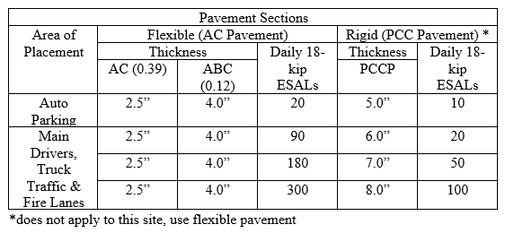
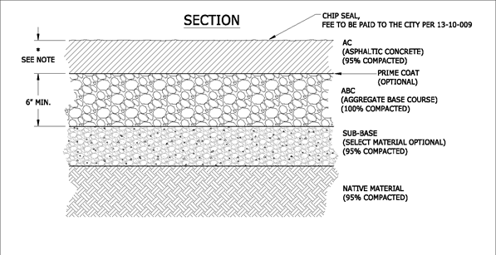
Task 3.3.4: Pavement Section Recommendation:
Minimum pavement thickness = 2.5 inches asphaltic concrete
  Per Cottonwood Engineering Design Manual
Legend:
AC- Aggregate Concrete
ABC- Aggregate Base Concrete
PCC- Portland Cement Concrete
ESAL- Equivalent Single Axial Load
PCCP- Portland Cement Concrete Pavement
Figure 10: Pavement cross section. City of Flagstaff. 2019. .

Slide 10
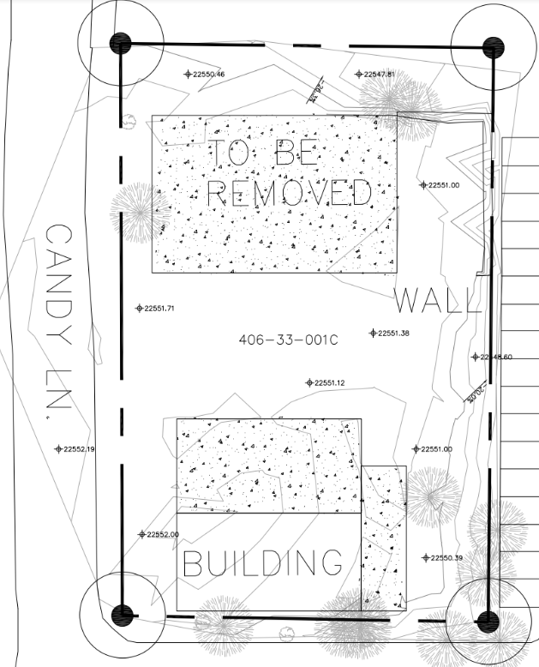
Task 4: Topographic
Mapping
Northern concrete pad in poor condition
No viable parking on site
Erosion is occurring on eastern property line
Figure 11: Existing Conditions Map

Slide 11
Task 5.1: Drainage Design
Table 2: Time of Concentration
Flow Time of Concentration
n | L(ft) | s (ft/ft) | Tc (hr) | Tc (min)
0.45 | 186.8617 | 0.05 | 0.05176 | 3.105336
Table 3: Summary of Drainage Calculations
Drainage Flowrate Calculations
Storm | Cf | C | Intensity (in/hr) | Area (acres) | Flow (cfs)
2-year | 1.2 | 0.95 | 3.29 | 0.520166 | 1.950934
5-year | 1.2 | 0.95 | 4.46 | 0.520166 | 2.664731
10-year | 1.2 | 0.95 | 5.42 | 0.520166 | 3.214
25-year | 1.2 | 0.95 | 6.83 | 0.520166 | 4.050115
50-year | 1.2 | 0.95 | 7.98 | 0.520166 | 4.732052
100-year | 1.2 | 0.95 | 9.25 | 0.520166 | 5.485148

Slide 12
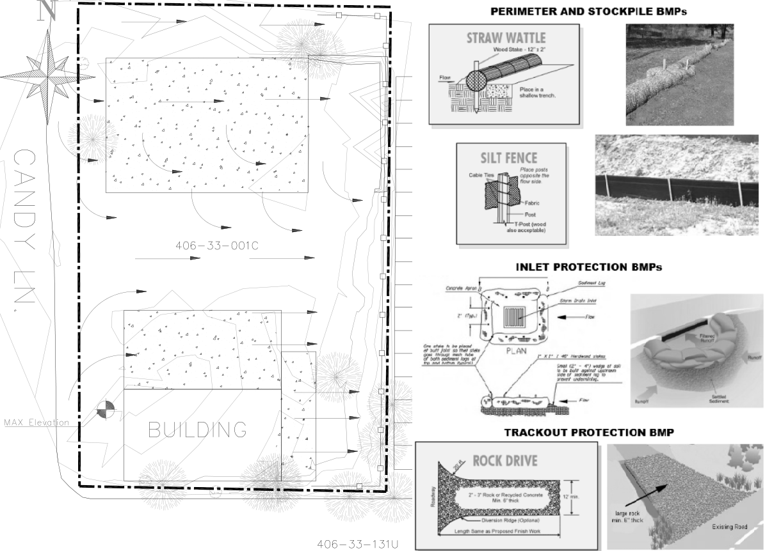
Figure 12: Proposed Erosion Control Plan

Slide 13
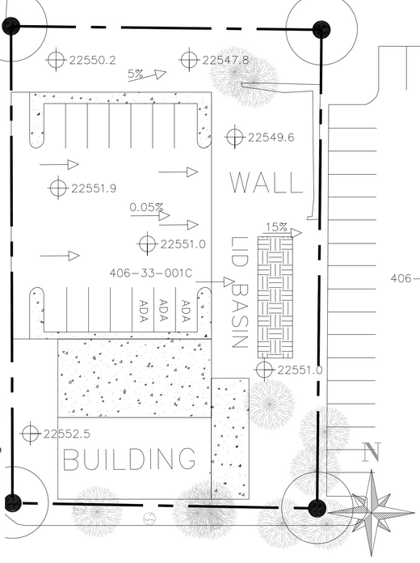
Site Design
Removed northern concrete pad
Added pavement section to improve parking and reduce erosion of site
Added LID basin to account for runoff on site
Figure 13: Proposed Site Plan with Grading and Drainage

Slide 14
Milestones 1/16/2019 - 4/26/2019
Table 4. MIlestones
Milestone | Expected Completion Date | Actual Completion Date
Land Survey | 2/12/19 | 2/8/19
Topography Map | 3/12/19 | 3/8/19
Parking Lot Design | 3/12/19 | 3/10/19
Proposed Drainage and Grading Plan | 3/12/19 | 3/10/19
60% Submittal | 3/12/19 | 3/12/19
90% Submittal | 4/15/19 | 4/13/19
Final Submittal | 5/7/19

Slide 15
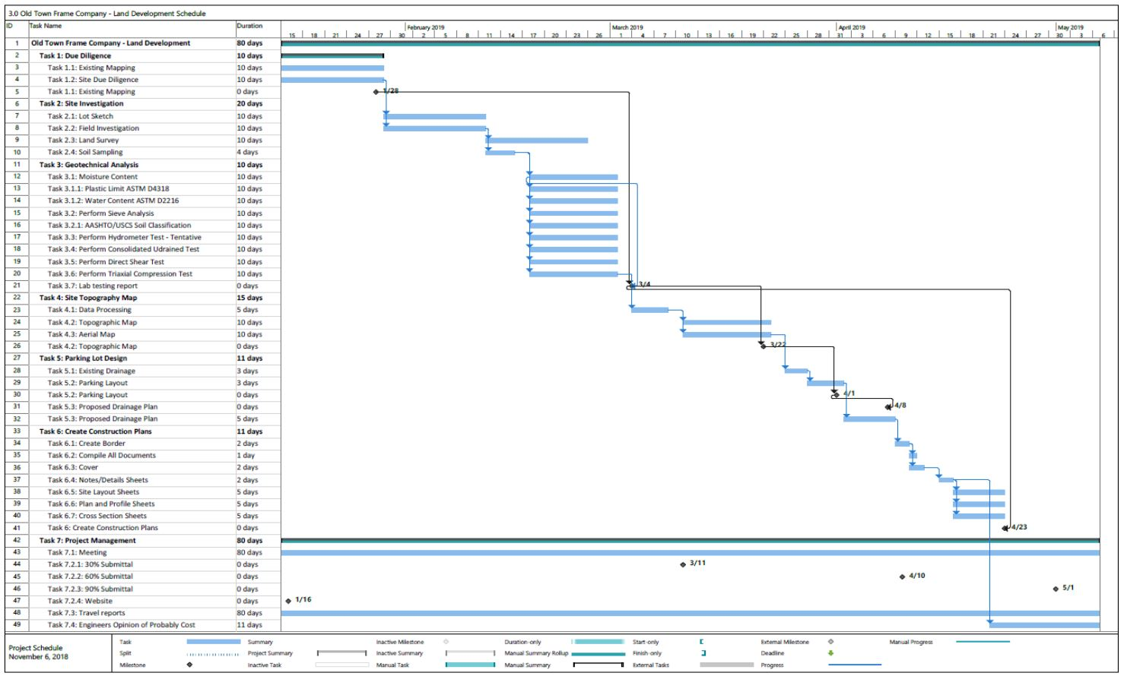

Slide 16
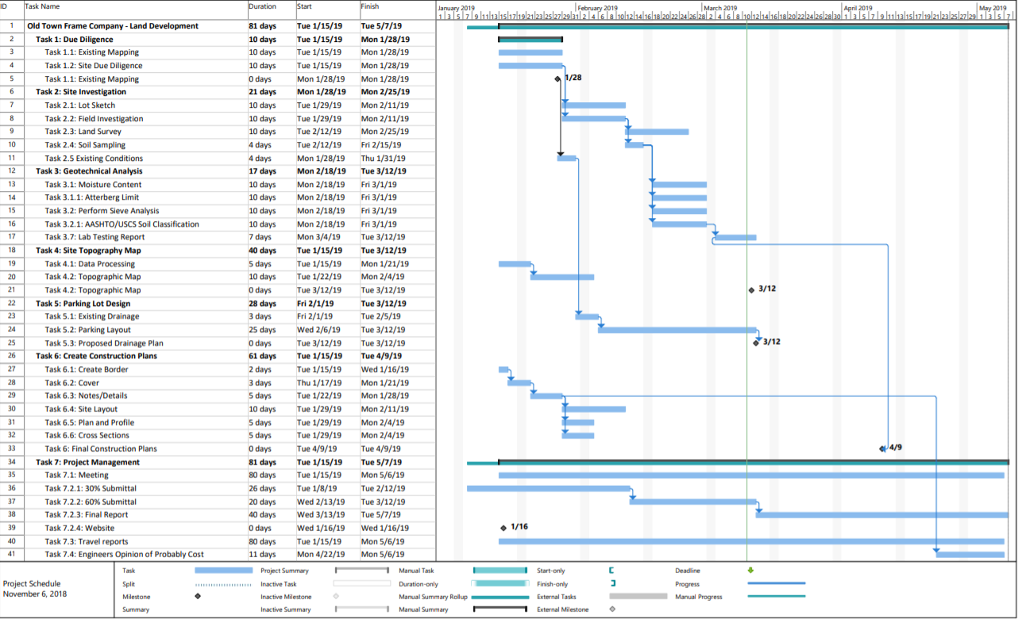
Land Survey
Topography Map
Parking Lot Design
Final Design
Figure 15: Schedule.

Slide 17
Staffing
Tasks | SENG | ENG | LTECH | INT | Total Hours | Total Hours Expected
Task 1: Due Diligence | 4 | 8 | 0 | 9 | 21 | 44
Task 2: Site Investigation | 10 | 10 | 10 | 22 | 52 | 116
Task 3: Geotechnical Analysis | 5 | 7 | 17 | 7 | 36 | 142
Task 4: Site Topo Map | 4 | 10 | 2 | 8 | 24 | 32
Task 5: Parking Lot Design | 7 | 20 | 4 | 18 | 49 | 59
Task 6: Create Construction Plans | 22 | 22 | 22 | 22 | 46 | 92
Task 7: Project Management | 55 | 59 | 50 | 58 | 222 | 254
Total Hours | 107 | 136 | 105 | 144 | 450 | 739
Senior Engineer
10 years of experience
Registered P.E.
Engineer
4 Years of experience
Registered E.I.T
Lab Tech
5 years of experience
Intern
Entry level
Current student, or recent graduate
Table 5: Staffing Recorded
289 hours under projected

Slide 18
Cost of Engineering Services
Table 6 Cost of Engineering Services
Personnel | Classification | Hours | Rate $/hr | Cost
 | SENG | 107 | $145.00 | $15,515.00
 | ENG | 136 | $90.00 | $12,240.00
 | LAB | 105 | $80.00 | $8,400.00
 | INT | 144 | $45.00 | $6,480.00
 | Subtotal |  |  | $42,635.00
2.0 Travel | Distance (miles) | Meetings | Rate $/mile | Cost
 | 120 | 2 | $0.54 | $129.60
3.0 Supplies |  | Hours | Rate $/hr | Cost
Survey Equipment |  | 5 | $50.00 | $250.00
4.0 TOTAL |  |  |  | $43,014.60
 |  |  | Projected Total | $88,028.31

Slide 19
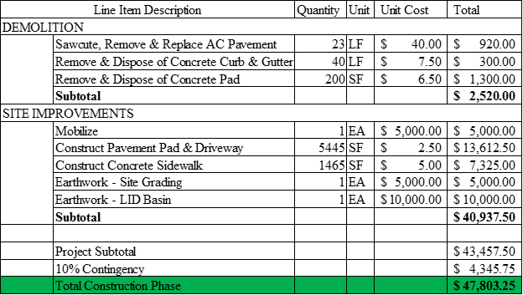
Engineer’s Estimate of Cost of Construction
Table 7 Cost of Construction

Slide 20
Impacts
Social
Reduce erosion occurring on adjacent church parking lot.
Economical
Bringing more business to site.
More room for parking.
Environmental
No tree removal needed.
Removal of northern concrete pad.

Slide 21
Questions

